Slide 1
Lecture 1
Algorithm Analysis
Arne Kutzner
Hanyang University / Seoul Korea

Slide 2
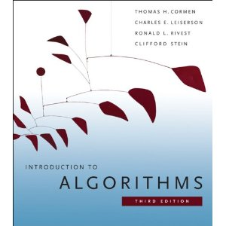
Literature
T.H. Cormen,
C.E. Leiserson,
R.L. Rivest,
C. Stein,
Introduction to Algorithms,
MIT-Press, 2009.
(third edition)
09/2021
Algorithm Analysis
L1.<number>

Slide 3
Contact
Contact data:
  E-Mail kutzner@hanyang.ac.kr
  Office Room 77-714
All course material will be available on Hanyang-LMS
09/2021
Algorithm Analysis
L1.<number>

Slide 4
Prof. Dr. Arne Kutzner / Weekly Schedule 2021.2
 | Mon | Tue | Wed | Thu | Fri
9:00 – 10:30
10:30 – 12:00
12:00 – 13:30
13:30 – 15:00
15:00 – 16:30
16:30 – 18:00
C++(11978)
9:00-11:00
(ITBT – 508)
C++(12838)
9:00-11:00
(ITBT – 508)
C++(12838)
13:00-15:00
(ITBT – 508)
C++(11978)
13:00 - 15:00
(ITBT – 508)
Zoom
Alg. Analysis
16:00– 17:30
(ITBT – 203)
Alg. Analysis
16:00-17:30
(ITBT – 203)
09/2021
Algorithm Analysis
L1.<number>

Slide 5
Makeup classes for public holidays
 | Mon 09.20 | Tue 09.21 | Wed 09.22 | Thu 09.23 | Fri 09.24
13:30 – 15:00
15:00 – 16:30
16:30 – 18:00
18:00 – 19:30
19:30 – 21:00
Zoom
Alg. Analysis
16:00– 17:30
(ITBT – 203)
Alg. Analysis
16:00-17:30
(ITBT – 203)
Zoom
Alg. Analysis
18:00– 19:30
Alg. Analysis
19:30– 21:00
09/2021
Algorithm Analysis
L1.<number>

Slide 6
Goals
Basic introduction to algorithms and their complexity
  Algorithmic solutions for several fundamental problems
  3 major “blocks”:
    Sorting
    Tree searching and balancing
    Graph related problems as e.g. shorted path problems
  “Feeling” for the complexity of problems (computational efforts to solve specific families of problems)
09/2021
Algorithm Analysis
L1.<number>

Slide 7
Provisional Schedule
Week
1 | Introduction, Growth of Functions, Asymptotic Notation
2 | Insertion Sort, Merge Sort, Divide and Conquer Principle
3 | Lower bounds for Sorting, Heapsort, Quicksort
4 | Complexity Analysis of Quicksort
5 | Counting Sort, Radix Sort, Bucket Sort
6 | Sorting Networks
7 | Midterm Examination
8 | Binary Search Trees - Minimum – Maximum, Deletion, Insertion
9 | Red-Black Trees, Insertion and Deletion of Vertices
10 | Elementary Graph Algorithms 1 – Depth First Search
11 | Elementary Graph Algorithms 2 – DAG, Strongly Connected Components
12 | Minimum Spanning Trees – Kruskal’s Alg., Prim’s Alg.
13 | Single Source Shortest Path Algorithms – Dykstra’s Alg.
14 | Course Review
15 | Final Examination
09/2021
Algorithm Analysis
L1.<number>

Slide 8
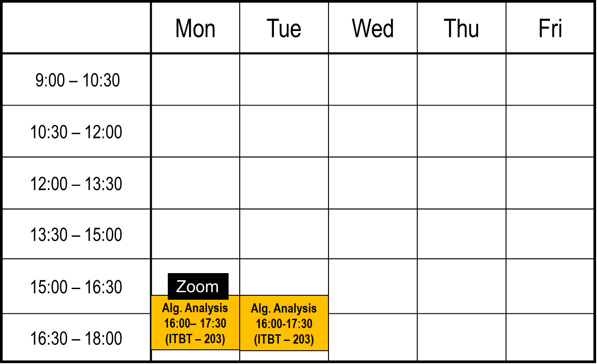
Structure of the Course (1)
Lecture
  Prerecorded Video plus PowerPoint slides for each week
  (Study the video in the 6 days before the Zoom session!)
  Zoom session for review of prerecorded video plus Q+A
2
1
09/2021
Algorithm Analysis
L1.<number>

Slide 9
Structure of the Course (2)
Homework Assignments
  Homework is for the preparation of midterm and final examination
  Reports have to be submitted as PDF via Hanyang-Blackboard
Study Groups
  Good strategy for learning conveniently
09/2021
Algorithm Analysis
L1.<number>

Slide 10
Grading
Composition of final grade:
  Midterm Examination (35%)
  Final Examination (35%)
  Homework Reports (20%)
  Attendance (10%)
09/2021
Algorithm Analysis
L1.<number>

Slide 11
Absolute Grading
A from 90% of max. reachable points
  (A+ 95% min)
B from 75% of max. reachable points
  (B+ 85% min)
C from 60% of max. reachable points
  (C+ 70% min)
D from 45% of max. reachable points
09/2021
Algorithm Analysis
L1.<number>

Slide 12
COVID-19 related …
Midterm and final examination will be offline!
Online Attendance is measured via
Hanyang-LMS.
Stay healthy!
09/2021
Algorithm Analysis
L1.<number>

